Slide 1

FUNDING PROPOSAL
CLICKATELL

Slide 2
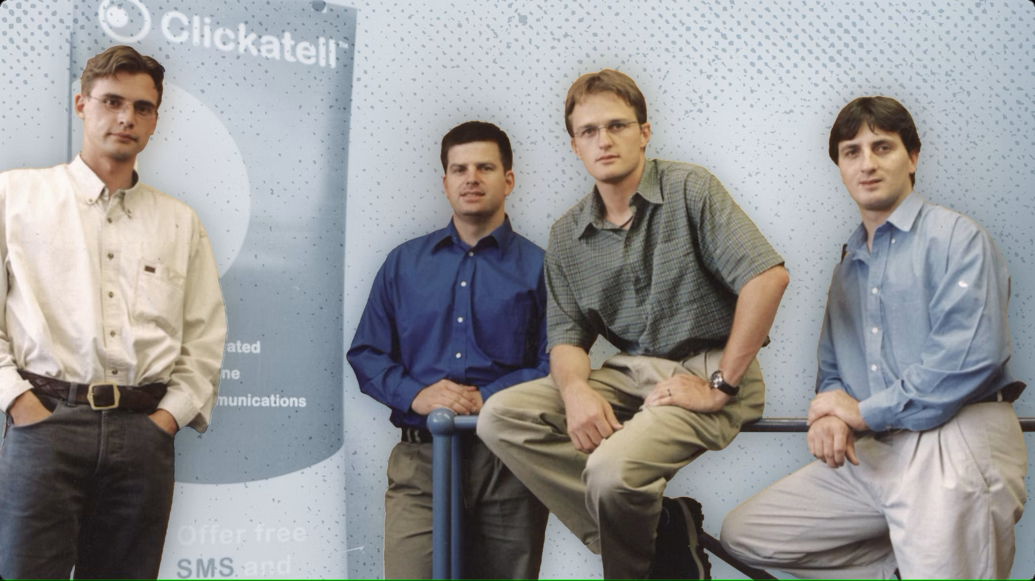
What Is Clickatell?
Casper
Patrick
Telecommunication Service Provider:
Platform for businesses to connect to customers over chatting services.
Pieter
What type of business is Clickatell?
Partnership
Why Partnership?
Clickatell started off by 4 friends joining together to create the business
Danie

Slide 3





What Does Clickatell Offer?
Advanced Messaging(Interaction)
Bot-Building (Chat-Flow/Drag and Drop)
Agent Support (Chat Desk)
Payment Processing (Chat-2-Pay)

Slide 4
Objectives
Rich & efficient communication
Growth In sales
Profit Increase

Slide 5
System Components
An SMS API is a type of API that allows your business to integrate SMS (Short Message Service) messaging into your existing software platforms.
An SMS Gateway enables a computer to send and receive SMS text messages to and from a SMS capable device over the global telecommunications network (normally to a mobile phone).

Slide 6
Our Business as a System
Transact
Connect
Interact
Clickatell offers a real-time customer engagement and transaction platforms that enable businesses to connect, interact, and transact with their customers via mobile chat and other digital channels.

Slide 7

Importance of Technology in Business
More efficiency
Technology is needed to help increase the efficiency of systems, products, and services.
Saves Time
Tasks that need incredible amount of manual works or manpower gets accomplished faster.
Digital transformation of manual tasks. Reduces the Amount of Equipment You Need.
Saves Costs
Competitive Advantage over other companies

Slide 8
Why we chose the Technologies we chose
Automation
API
Big Data
For delivering a more tailored experience
For the mass SMS messaging of clients
Used for solving queries without the hassle of a phone call

Slide 9
Technologies Clickatell uses in their services
Technologies Clickatell uses in their day to day
BIG DATA
VISUAL STUDIO
AUTOMATION
MS TEAMS
APPLICATION PROGRAMMING INTERFACE
ELECTRONIC DEVICES
INSTANT MESSAGING AND SHORT MESSAGE PEER TO PEER
SERVERS

Slide 10
Thank You
Any Questions?

